Slide 1
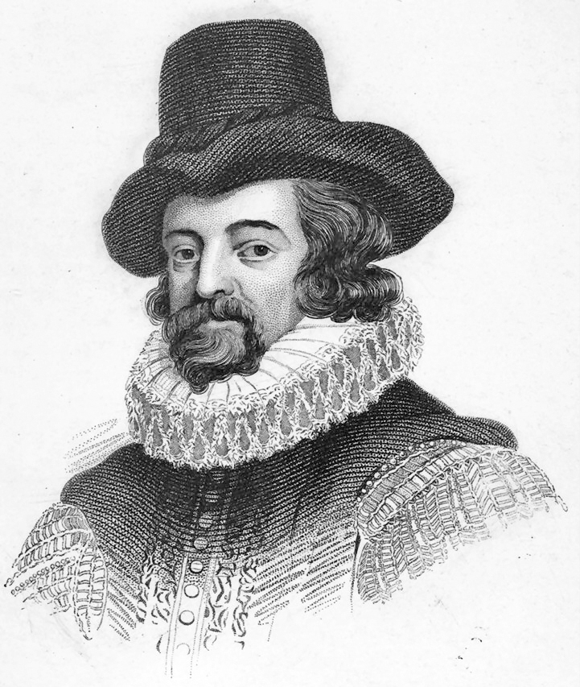
Six Degrees of
Francis Bacon
Team 8
Patrick Ban
Yawen Duan
Jaymin Patel

Slide 2
Dataset We Are Working On
Questions We Are Interested In
Analysis Approach
First Results & Findings

Slide 3
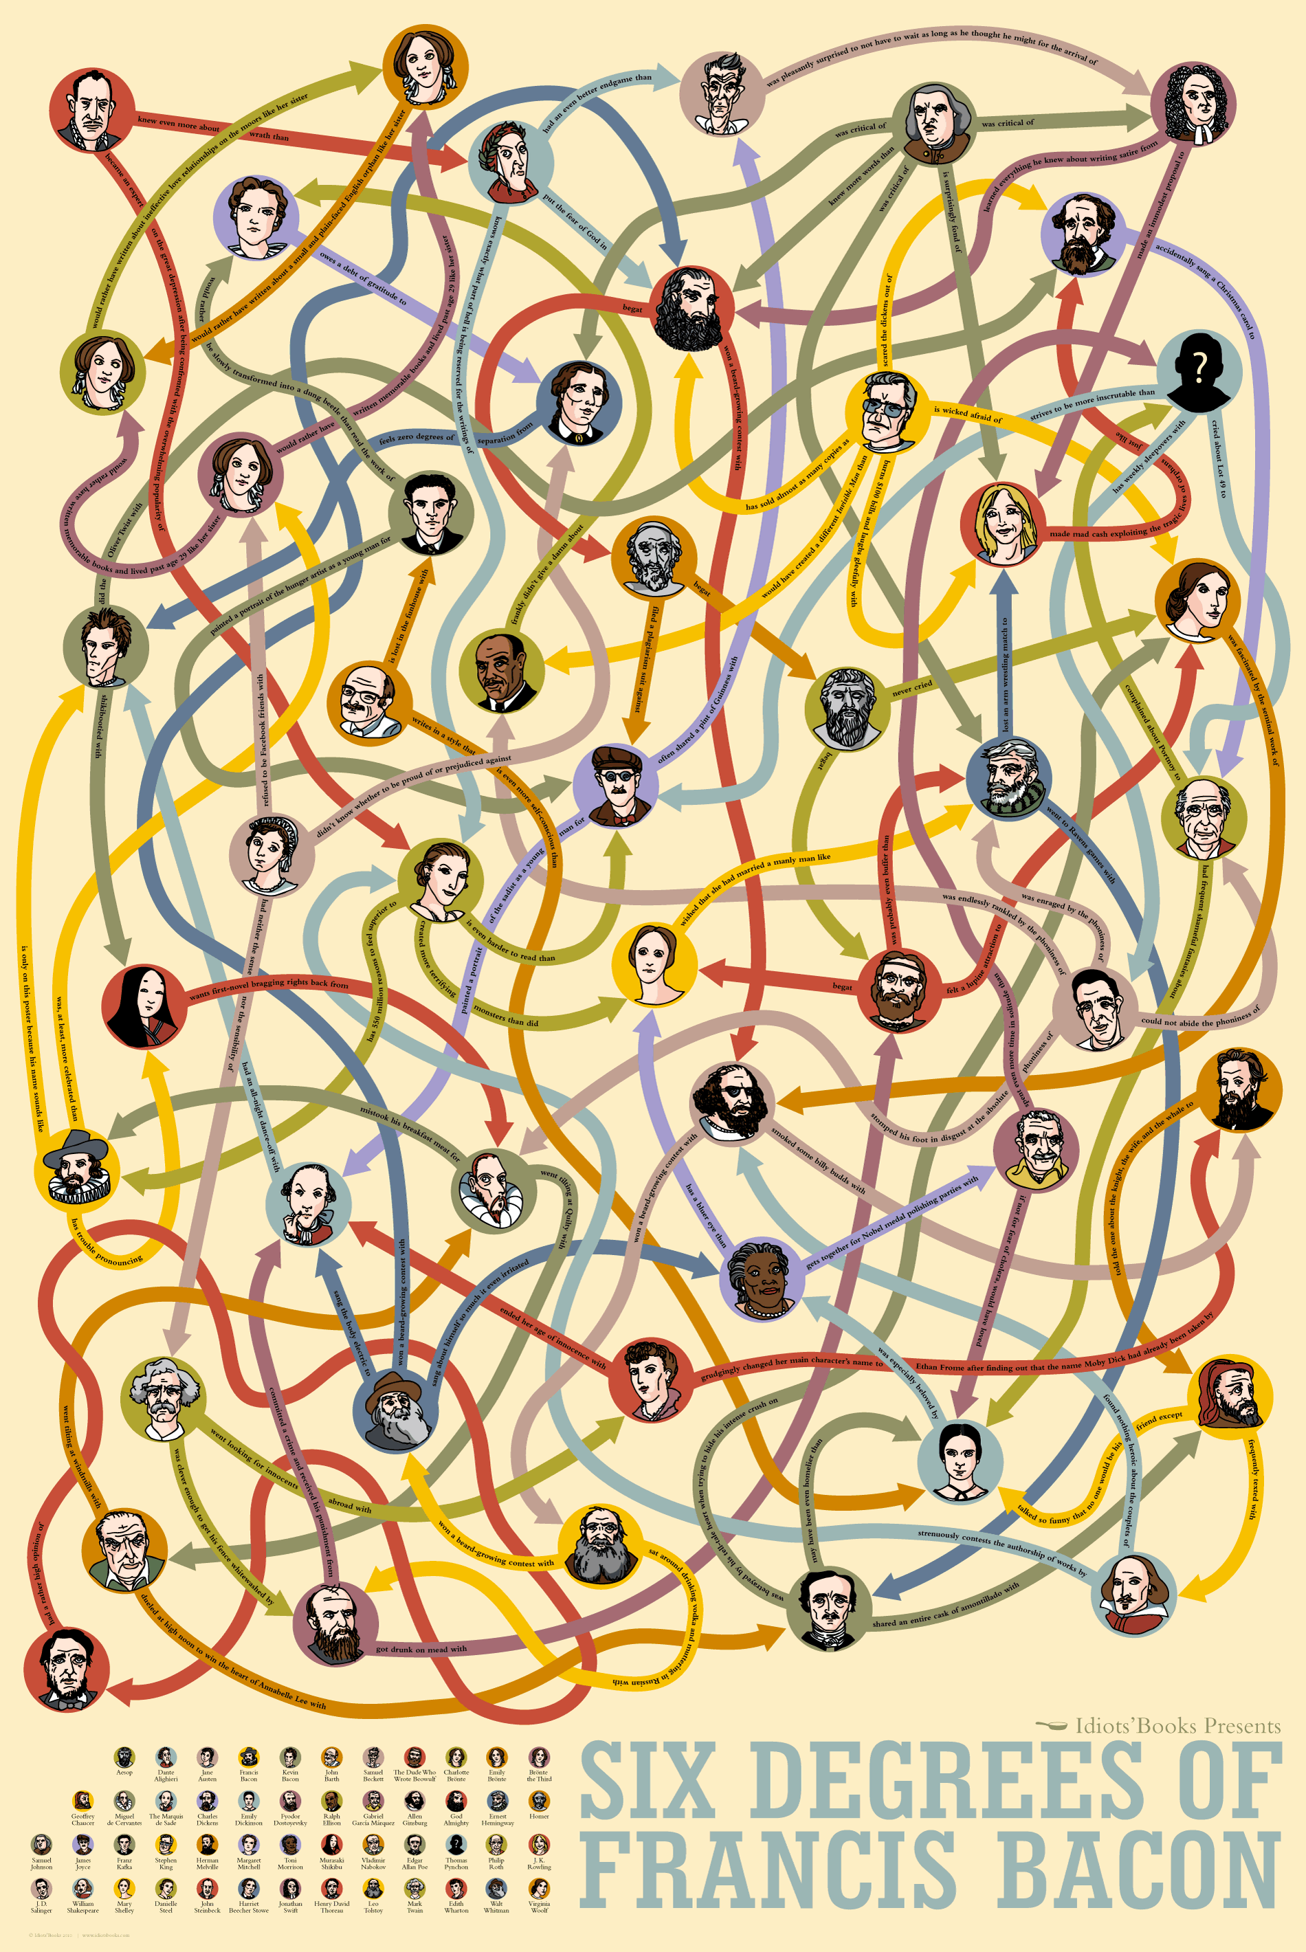
Dataset
Francis Bacon
English philosopher, statesman, scientist, jurist, orator, and author, the father of empiricism
13983 People
Gender, birth year, death year, historical significance
191402 Edges
Start year, end year, maximum confidence, original confidence
109 Groups (494 People)
Name, description, start year, end year, member list

Slide 4
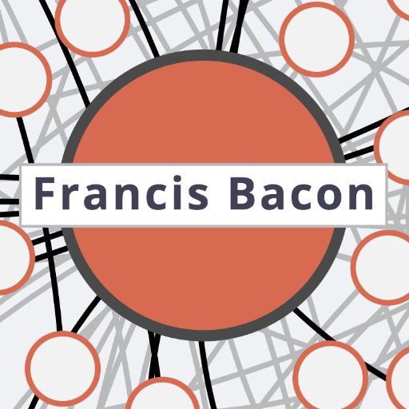
Questions
Can everyone in this network be linked to Francis Bacon within 6 steps?
Which type (occupation, historical significance, gender, group) of people are more central? Linked to Francis Bacon within smaller steps?
Is Francis Bacon the most central people? If not, who is?
Does the network change over time?

Slide 5
Analysis Approach
Plot network, color nodes by group/ occupation, color edges by maximum confidence (1 to 4)
3 Networks
All relationships network (13983 nodes, 191402 edges)
Occupation network (8 occupation, 2823 nodes, 23028 edges)
Co-group network (109 groups, 494 nodes, 7059 edges)
For each node, calculate the shortest path to Francis Bacon
For each network, calculate degree, betweenness, closeness, eigenvector centrality and find out the most central people
Plot the centrality against time

Slide 6
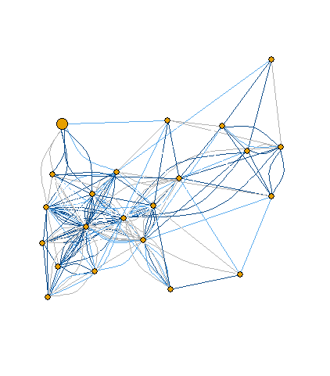
Results & Findings
--All Relationships Network
2.3
Average steps to be linked to Francis Bacon
5.0
Max steps to be linked to Francis Bacon
42
Francis Bacon is the 42nd central people
11
11% are strong ties (maximum confidence >60)

Slide 7
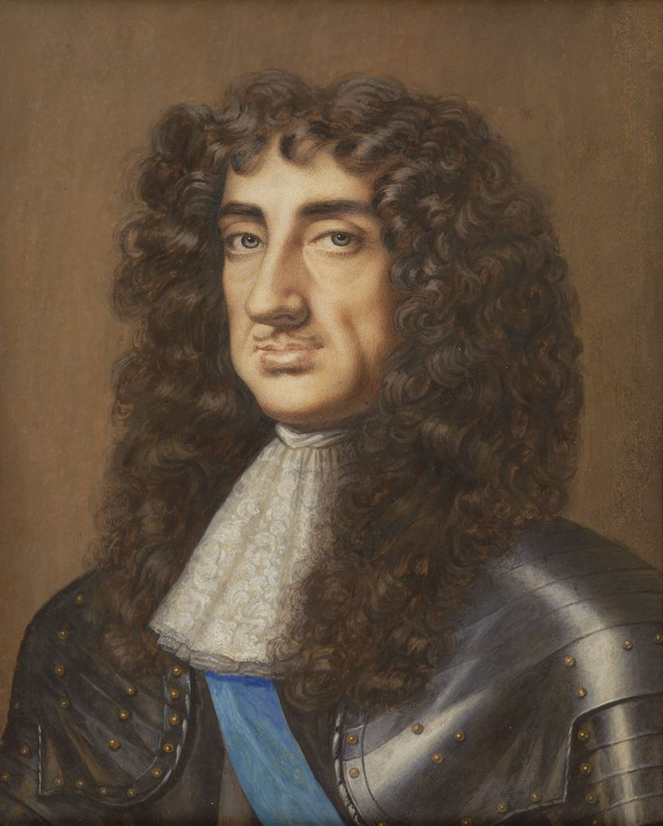
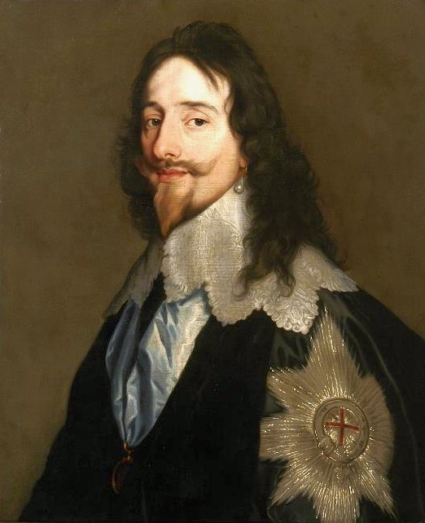
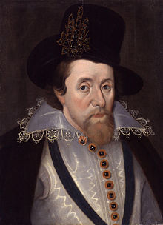
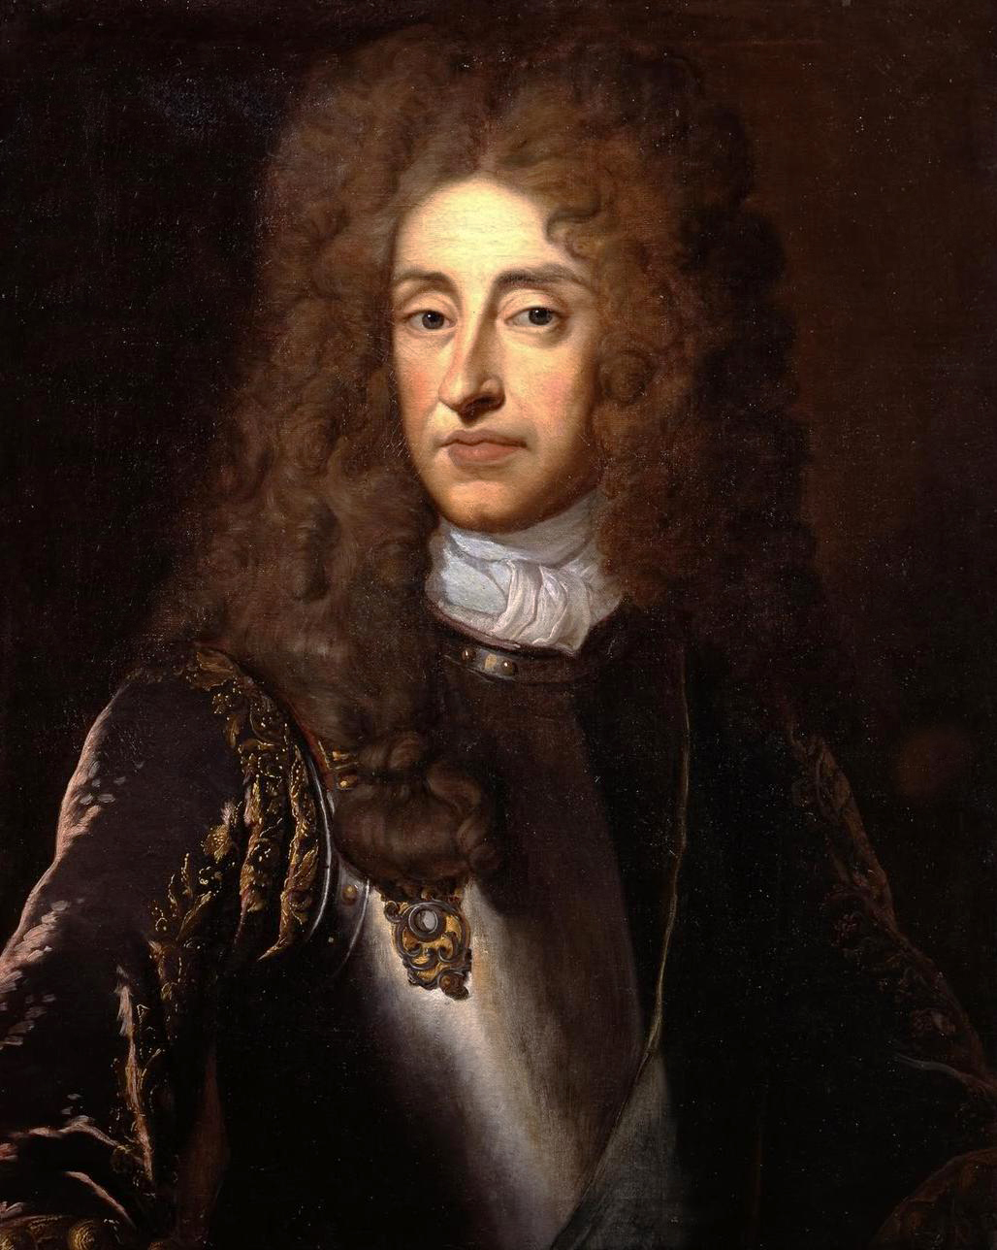
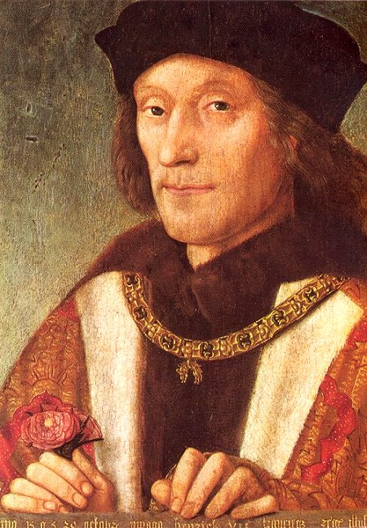
Results & Findings
--All Relationships Network
King Charles II
King Charles I
King James I and VI
King James II and VII
King Henry VII
1630-1685
Bacon 1.99
Degree 2184
Betw 7.9
Clos .04
Eigen 1.00
1600-1649
Bacon 2.04
Degree 2101
Betw 5.5
Clos .04
Eigen .096
1566-1625
Bacon 2.10
Degree 1613
Betw 5.6
Clos .04
Eigen .097
1633-1701
Bacon 2.14
Degree 1272
Betw 3.7
Clos .04
Eigen .051
1492-1547
Bacon 2.75
Degree 1249
Betw 2.8
Clos .04
Eigen .047

Slide 8
Results & Findings
--All Relationships Network
Edmund Burwell
1574-1672
King Charles II
Sir Jonas Moore
king of England, Scotland, and Ireland
1630-1685
Father-in-law
mathematician and patron of astronomy
1617-1679
brother
Jeffrey Pitman
draper and haberdasher
1561-1627
Thomas Burwell
Seth Ward
Francis Bacon
John Cosin
civil lawyer
1603-1673
bishop of Durham
1595-1672
Astronomer and bishop of Exeter and Salisbury
1617-1689
Politician
1561-1626
William Oughtred
Henry Moore
Mathematician
1575-1660
Jesuit
1587-1661

Slide 9
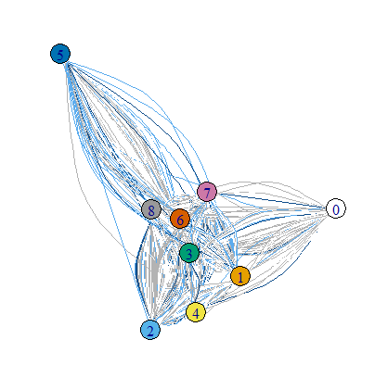
Results & Findings
--Occupation Network
2.8
Average steps to be linked to Francis Bacon
Group | degree | betw | close | eigenc
1 | 9.267516 | 1704.489 | 0.003878 | 0.004794
2 | 11.42857 | 2272.61 | 0.003843 | 0.008164
3 | 10.87746 | 2223.265 | 0.003749 | 0.011966
4 | 11.21935 | 2543.348 | 0.003851 | 0.008019
5 | 7.642857 | 1025.159 | 0.003649 | 0.00429
6 | 17.36913 | 3675.142 | 0.004044 | 0.027178
7 | 15.46457 | 5344.998 | 0.003897 | 0.015879
8 | 11.07568 | 2152.95 | 0.003701 | 0.01659
5.0
1.Painters 2.mathematicians 3.clergy
4.Scholars 5.gardeners 6.military
7.Historians 8.landowners 0. Francis Bacon
Max steps to be linked to Francis Bacon
6.9
6.9% are strong ties (maximum confidence >60)

Slide 10
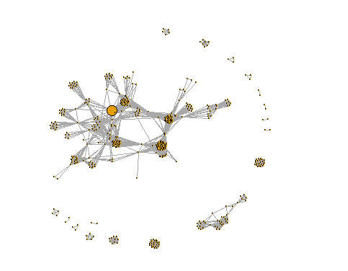
Results & Findings
--Co-group Network
Francis Bacon is not central in this network either
Top 6 central people all belong to group “Royal Academy of Music I and II” (1700-1734)
Top central groups:
Royal Academy of Music I and II
Opera of the Nobility
Whigs
Royal Society

Slide 11
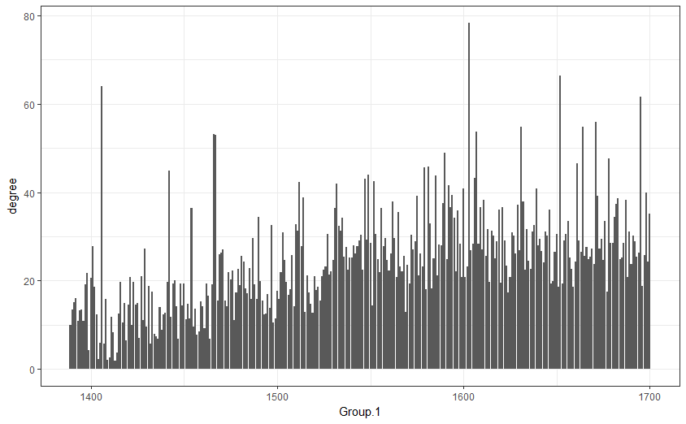
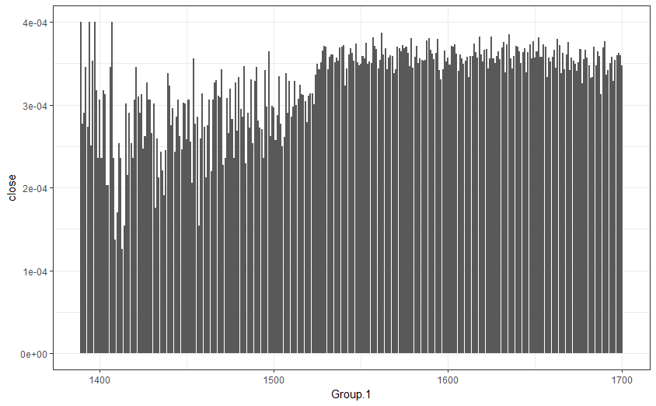
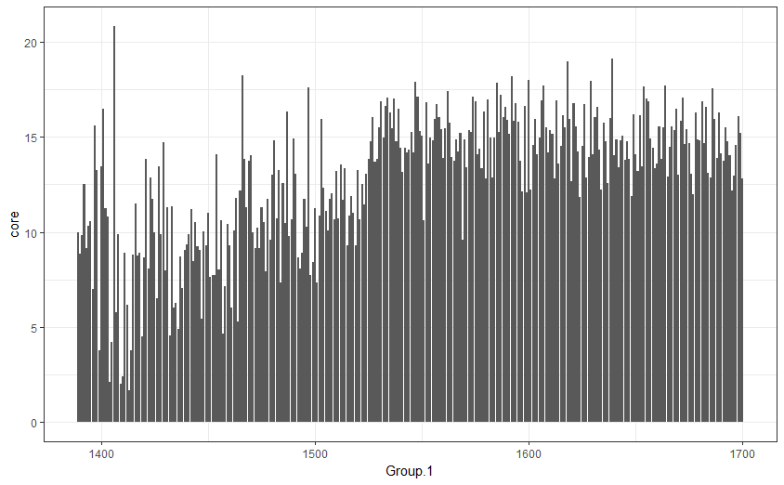
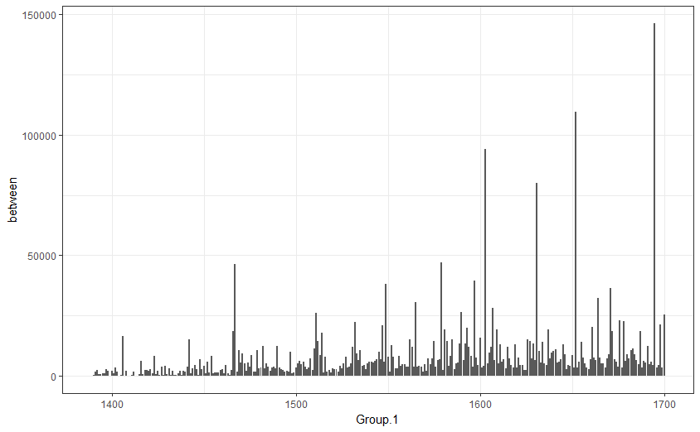
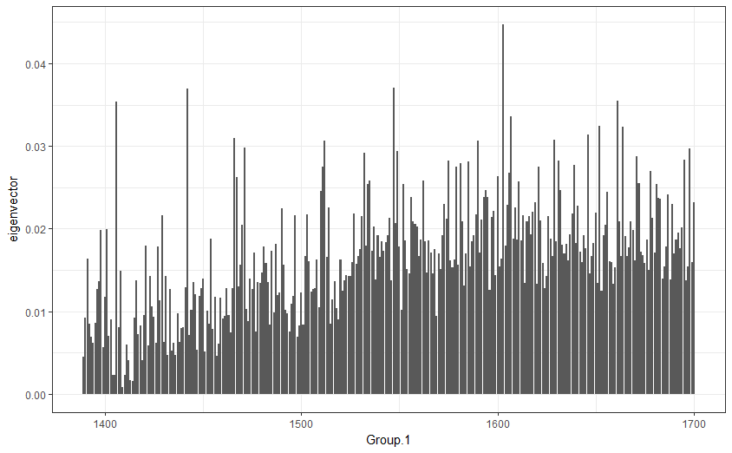
Results & Findings
--Does the network change
over time?

Slide 12
Thank you

